Slide 1
Problem identification
Determine the best ticket price for Big Mountain resort and the changes to cut costs without undermining the ticket price for this season given that the operating cost has increased $1,540,000.
H
1
Context
4
Constraints within solution space
Big Mountain Resort, a ski resort located in Montana, has recently installed an additional chair lift to increase the distribution of visitors across the mountain. This chair increases the operating costs by $1,540,000 this season. There is a suspicion that Big Mountain is not capitalizing on its facilities as much as it could. The business wants the guidance on how to select a better value for their ticket price.
There might be other factors that affect the price besides the given table columns
5
Stakeholders to provide key insight
2
Criteria for success
Jimmy Blackburn – Director of Operations
Alesha Eisen – Database Manager
Strong evidence from data to determine if the ticket price is reasonable in its market segment and which changes can be made to cut costs
3
Scope of solution space
6
Key data sources
The pricing strategy is determined based on competitors in Big Mountain Resort’s market segment.
CSV file from database manager
H
D
E
I
P
Notes:
Hypothesis: Create a Hypothesis with an emphasis on SMART principles. (S – Specific, M – Measurable, A – Achievable, R – Realistic, T – Timebound). If you cannot do this, you do not have a good grasp on the business problem.
Context: With context, we have clearly identified the problem at hand and have elucidated on how our initiative may solve this problem, alongside the commercial implications this will have on the business.
Criteria for Success: Clearly defining the criteria for success ensures that the scope of your work is clearly defined and understood. Otherwise, if this isn’t defined – your work will never end which will result in mismatched expectations.
Scope of Solution Space: Scoping out the solution space ensures that the business initiative is SPECIFIC for a certain segment or area. This prevents solutions that have been developed being scaled and applied for all other business units that the solution may not be responsible or scalable for.
Constraints within Solution Space: Looking forward, what are the foreseeable problems we are likely to encounter? Could this be stakeholder resistance? Could this be we don’t have access to the right data?
Stakeholders to provide key insight: Who are the people I need to speak to, to get the answers I need for my data analysis?
What key data sources are required?
Based off my discussions with the key stakeholders – can we clearly list out all the data sources we need so we can make a highly targeted request as opposed to a scatter-gun approach where we ask for a bit of everything?

Slide 2
Recommendation and key findings
1
Key findings:
2
Recommendation:
The top four features that affect the ticket price are fastQuads (the number of fast four person chairlifts), , runs (number of runs on the resort) , Snow Making_ac (total area covered by snow making machines in acres) and vertical_drop (vertical change in elevation from the summit to the base).
Increase fastQuads, runs and vertical_drop results in a great increase in revenue, while increasing snow making_ac does not cause a lot of change.
We would suggest to add a run, increase the vertical drop by 150 feet, and install an additional chair lift. This scenario increases support for the ticket price by $8.61, correspond to $15,065,471 increase in revenue over the season.
Closing the least used runs can be considered as well. Since closing one run has no effect on the price, we can try closing one run first. Then we can try closing 5 runs, then 8 runs etc. to see if it benefits our business.
From our model, adding a small snow making area makes almost no difference. Therefore, we do not recommend to try this.

Slide 3
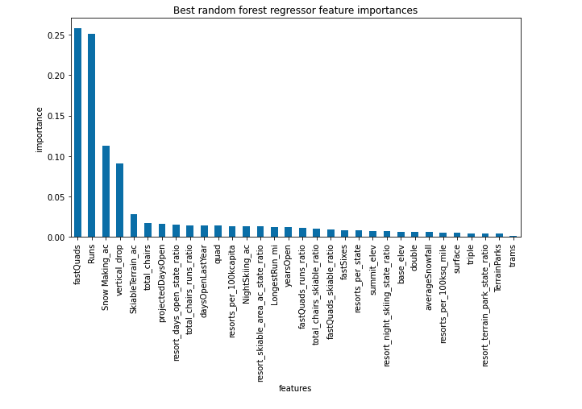
Modelling result and analysis
The top four features that affect the ticket price are fastQuads (the number of fast four person chairlifts), runs (number of runs on the resort) , Snow Making_ac (total area covered by snow making machines in acres) and vertical_drop (vertical change in elevation from the summit to the base). The importance of all features is shown as following:

Slide 4
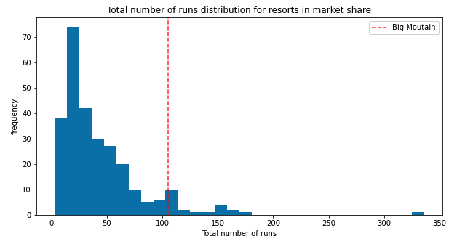
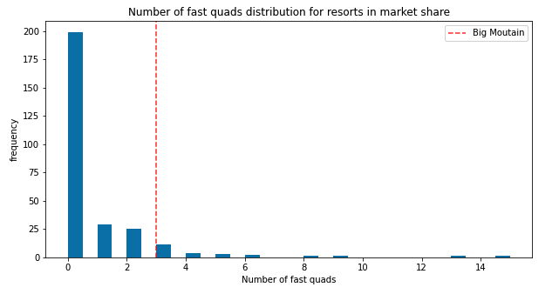
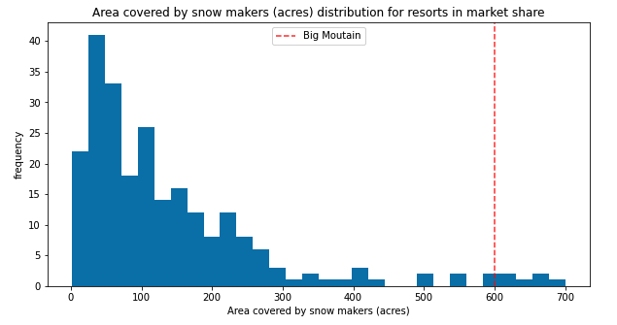
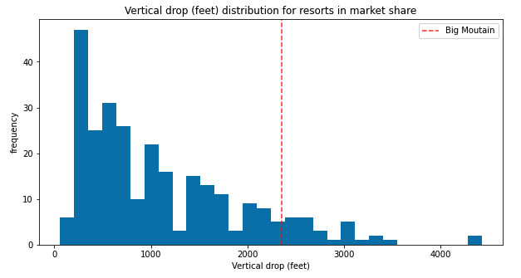
Modelling result and analysis
Considering the top four features in details, we have the relationship of Big Mountain resort with other resorts being described as following. We can see that except for the area covered in snow makers, Big Mountain Resort is not outstanding in other features when comparing with its competitors. This suggests that there is still room to improve number of runs, fast_quads and vertical drop.

Slide 5
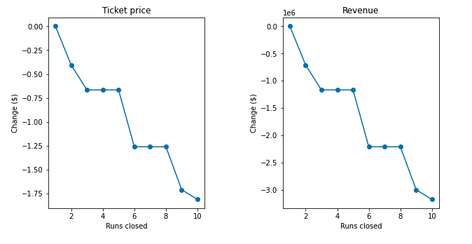
Modelling result and analysis
Indeed, our model shows that if we add a run, increase the vertical drop by 150 ft, and install an additional chair lift, we can raise our ticket price by $8.61. This corresponds to an increase of $15,065,471 in revenue over the season.
The model also shows that we do not benefit much if we increase the area covered by snow makers by 2 acres in addition to adding a run, increasing the vertical drop by 150 ft and installing an additional chair lift. By doing this, we expect the revenue to increase $17,322,717, which is only $2M greater than the previous solution. This is because Big Mountain Resort already have more snow coverage than its competitors.
If spending more money on the facility is not an option, we can consider cutting cost by closing up the least used runs. The following chart shows us the expected ticket price change and the revenue change if we close up to 10 least used runs. From the chart, we can see that closing one run does not affect the revenue so we can try close one run first. Then we can try close 2 runs, then 5 runs, then 8 runs and so on, noting that closing 3,4 or 5 runs yield the same revenue, and closing 6,7,8 runs yield the same revenue as well.

Slide 6
Summary and conclusion
To summarize, the data shows that the top four features that affect the ticket price are the number of fast four person chairlifts (fastQuads), the number of runs of the resort, the total area covered by snow makers (snow_making_ac) and the vertical change in elevation from the summit to the base. Among these features, Big Mountain resort only has snow_making_ac above the average when comparing with its competitors, while the other 3 features are under average.
We would suggest to add a run, increase the vertical drop by 150 ft, and install an additional chair lift. By doing this, we can raise our ticket price by $8.61. This corresponds to an increase of $15,065,471 in revenue over the season. If we want to raise the price ticket to cover the cost of the new additional chair lift, it would be $0.88 increase in the price, which is unnoticeable.
If the budget is tight and we want to reduce the cost instead of adding more facility, we can close 1,2,5 or 8 runs. These numbers are the optimal choices and the detailed reason can be found in the previous slide.

